Slide 1
Analyzing the experience and Device Preferences of Singapore Android users
Gustavo Fernandez
December 17, 2023

Slide 2
Agenda
Introduction
Data Overview, Methodology & Key Findings
Domestic Android User Experience
Test Performance by Region & Network Operators Analysis
Connection Types & Top Devices among Singapore Domestic Users
Device Analysis & Model Distribution by Operator
Roaming in Singapore: Test Counts & Analysis by Region
Roaming User Experience & Device Preferences of Roamers in Singapore
Conclusion

Slide 3
Introduction
Data Overview & Methodology
Key Findings:
Regional User Distribution and Performance:
Central and North-East Regions: Predominant areas for user tests in Singapore.
Exceptional Performance in North-East: Median download/upload speeds of 167.7 Mbps/44.4 Mbps, significantly higher than other regions.
Network Operator Market Presence:
Dominance of StarHub and SingTel: Leading in test counts, suggest larger market share and user base in Singapore.
StarHub leads significantly in median download and upload speeds (169.3 Mbps/44Mbps), suggesting a strong network performance in these areas. The median latency for StarHub is also the lowest among the operators..
Device Preferences and Network Performance:
Samsung's Market Hold: Predominant among domestic users, with models like Galaxy S9 highly prevalent.
Network-Model Alignment: Specific models, e.g., Samsung Galaxy S9, overwhelmingly used on the StarHub network.
Roaming Insights:
Lower Speeds and Higher Latency for Roamers: Malaysian and Indonesian roamers experience reduced speeds and higher latency compared to domestic users.
Roaming Operator Influence: "Tsel-PakaiMasker" and "TELKOMSEL" lead in roaming tests, indicating preference among Indonesian roamers.
Roaming Device Preferences: Malaysian and Indonesian roamers favor brands like Xiaomi and Realme
Network performance data for Android users in Singapore.
Data Sourced via end-user tests.
Data Collection Period: January 1 – Feb 28, 2021.

Slide 4
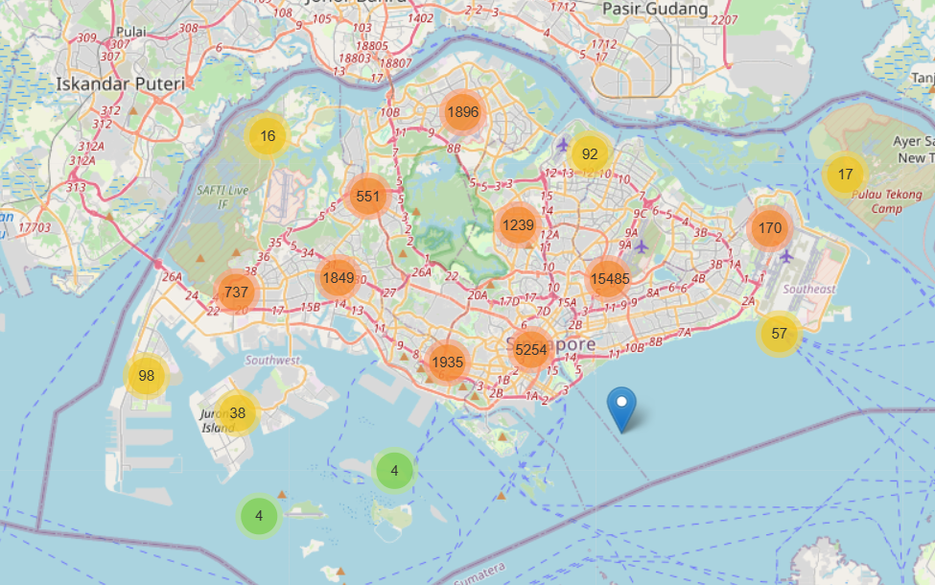
Users tested mostly in the Central and North-East Regions of Singapore

Slide 5
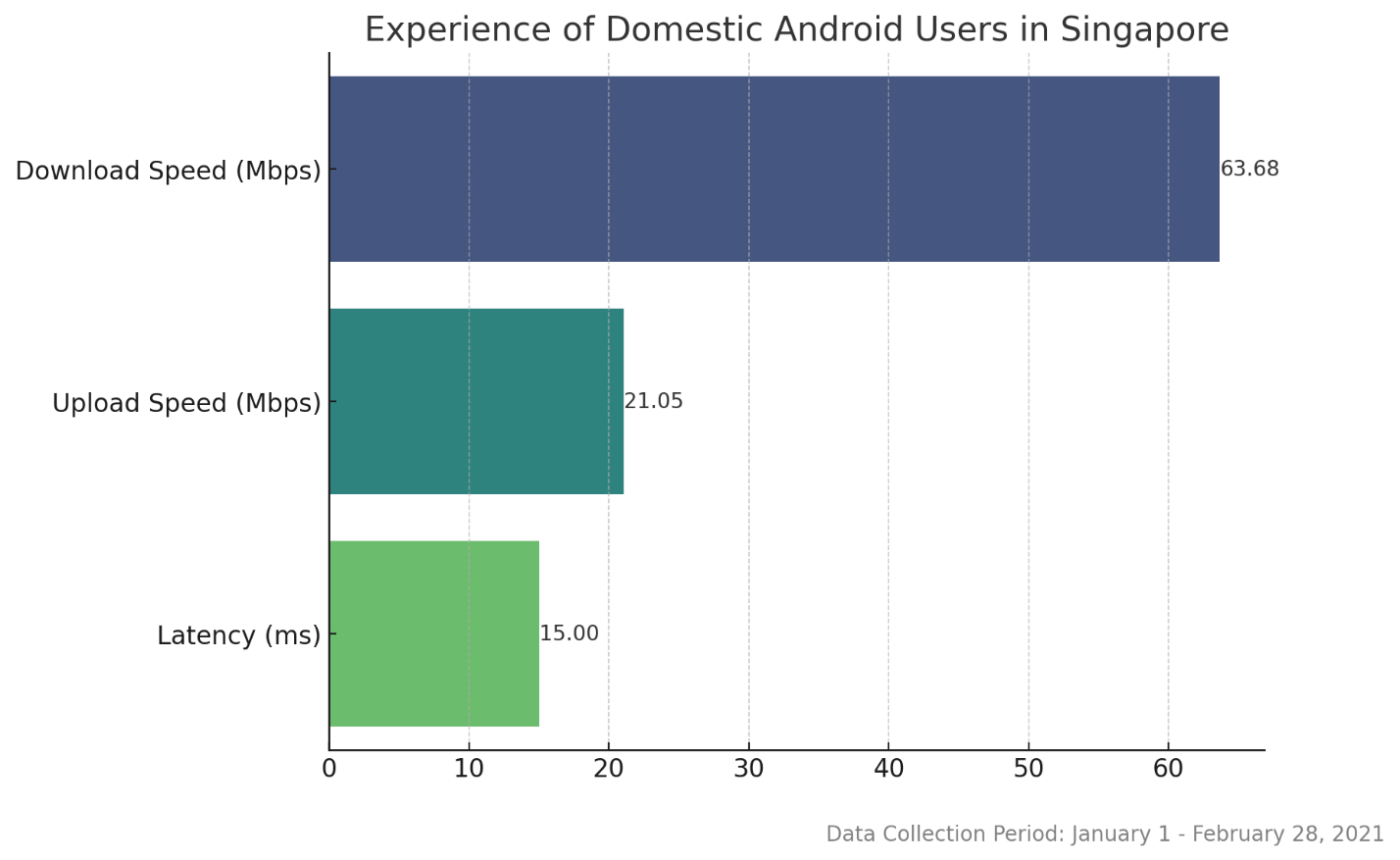
Overall Experience of Singapore users
The typical everyday speeds and latency an Android device Domestic user experiences in Singapore.

Slide 6
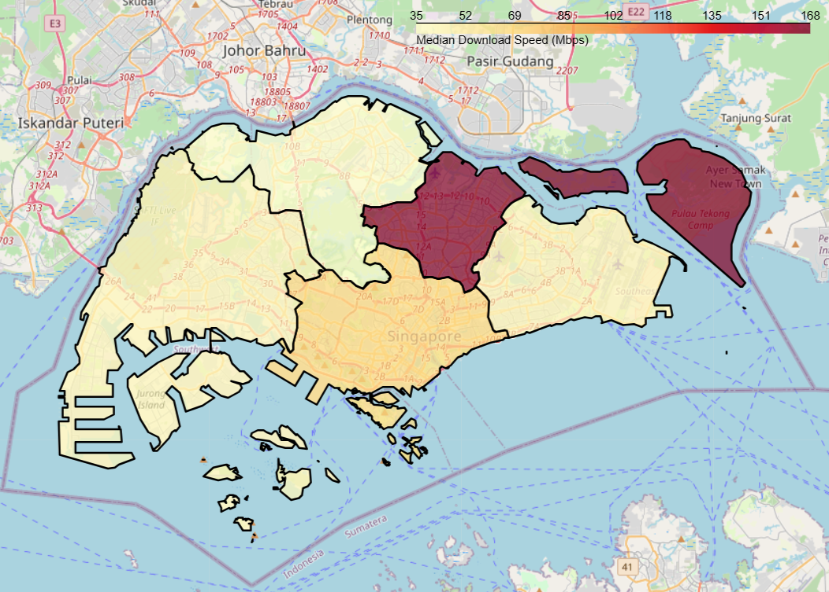
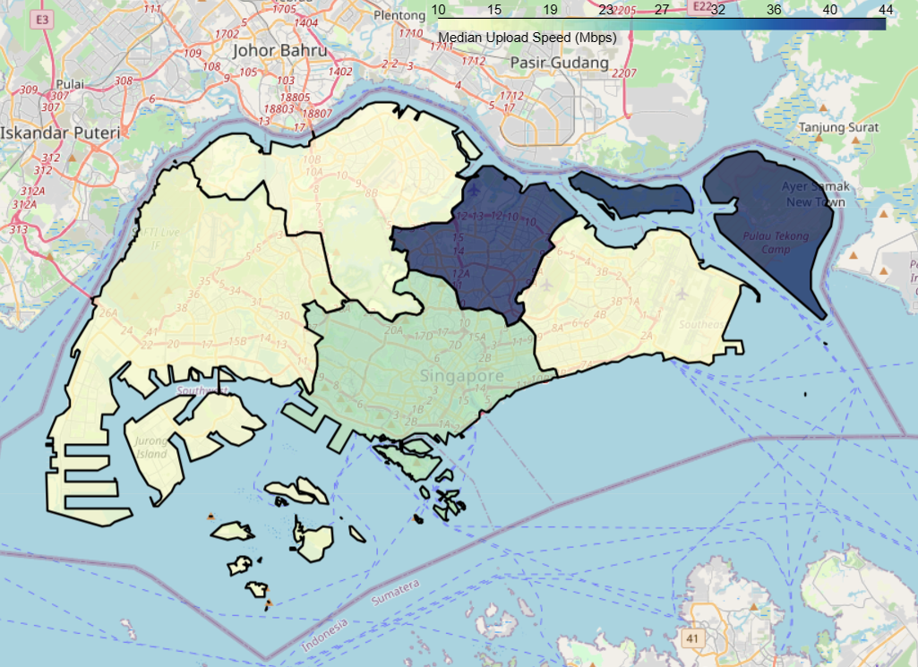
Download and Upload Speed Experience by Region
North-East Region test results stands out with significantly higher median download (167.7 Mbps) and upload (44.4 Mbps) speeds compared to other regions.
The Central Region shows a good download (64.592 Mbps) and upload (20.596 Mbps) speeds.
Notes:
North-East Region's High Speeds: The North-East Region stands out with significantly higher median download (167.750 Mbps) and upload (44.4415 Mbps) speeds compared to other regions. This could indicate a more advanced or newer network infrastructure in this area, possibly due to recent developments or targeted network improvements.
Central Region's Balanced Performance: The Central Region shows a good balance between download (64.592 Mbps) and upload (20.596 Mbps) speeds, which is crucial for both consumption and production of online content. This balance might reflect a well-established network that caters to a mix of residential and commercial users.
Lower Speeds in North and West Regions: The North and West Regions have lower median speeds for both download and upload. The North Region, in particular, has the lowest download (35.483 Mbps) and upload (10.433 Mbps) speeds. This could be due to a variety of factors like older network infrastructure, geographical challenges, or lower investment in network upgrades in these areas.
Variability Across the Island: The variability in speeds across different regions suggests a disparity in network coverage and quality. This could impact the digital experience of residents and businesses, especially in areas with lower speeds.
Implications for Telecom Strategy: For telecom providers and policymakers, these insights could guide infrastructure investments, network upgrades, and targeted initiatives to ensure more uniform network quality across Singapore.
Potential for Further Analysis: Correlating these speeds with population density, commercial activity, and user behavior data could provide deeper insights into network usage patterns and help in more effective network planning and optimization.
Impact on Users and Businesses: Regions with higher speeds might offer a more favorable environment for businesses that rely heavily on fast internet, like tech companies, while users in regions with lower speeds might experience limitations in activities like streaming, gaming, or using cloud-based services.

Slide 7
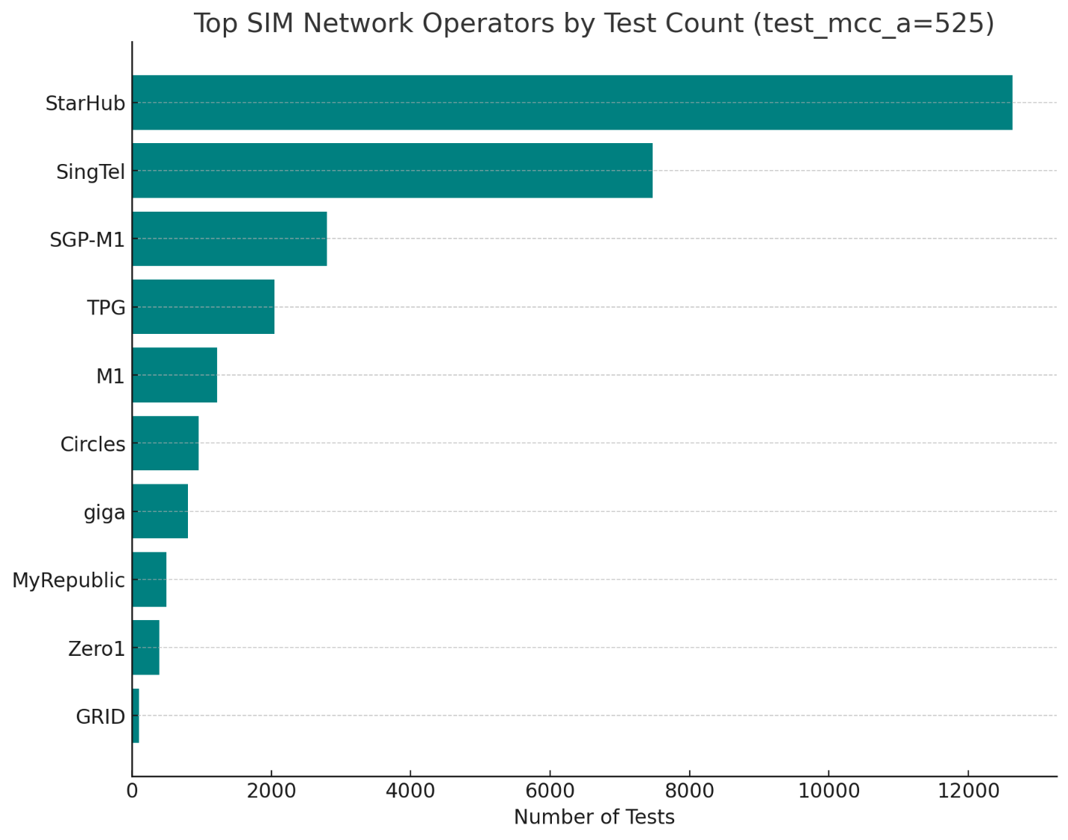
Test by Network Operator in Singapore
Dominant Operators: StarHub leads significantly in terms of the number of tests conducted, followed by SingTel. This suggests that these two operators might be the most popular or widely used among users who conducted the tests.
Market Share Indication: The high number of tests for StarHub and SingTel compared to other operators could indicate a larger market share or user base in Singapore for these providers, at least among the users who have conducted these tests.
Variety of Operators: There is a diversity of operators in the market, as shown by the presence of several other operators like SGP-M1, TPG, M1, Circles, giga, MyRepublic, Zero1, and GRID. This diversity points to a competitive telecom market in Singapore

Slide 8
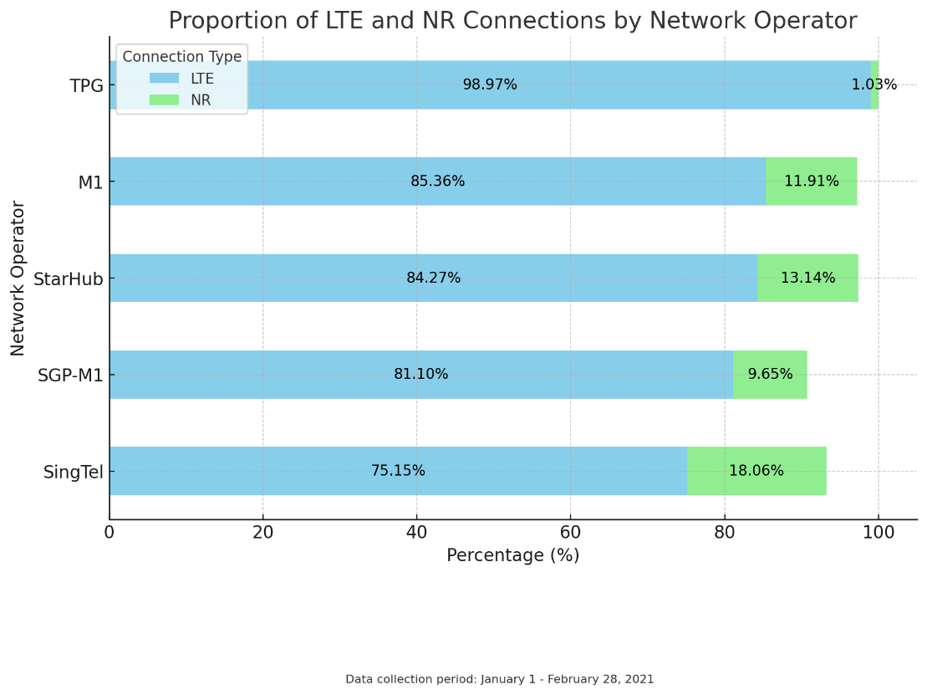
Singaporean Mobile Users Rely on LTE For Their Mobile Broadband Needs

Slide 9
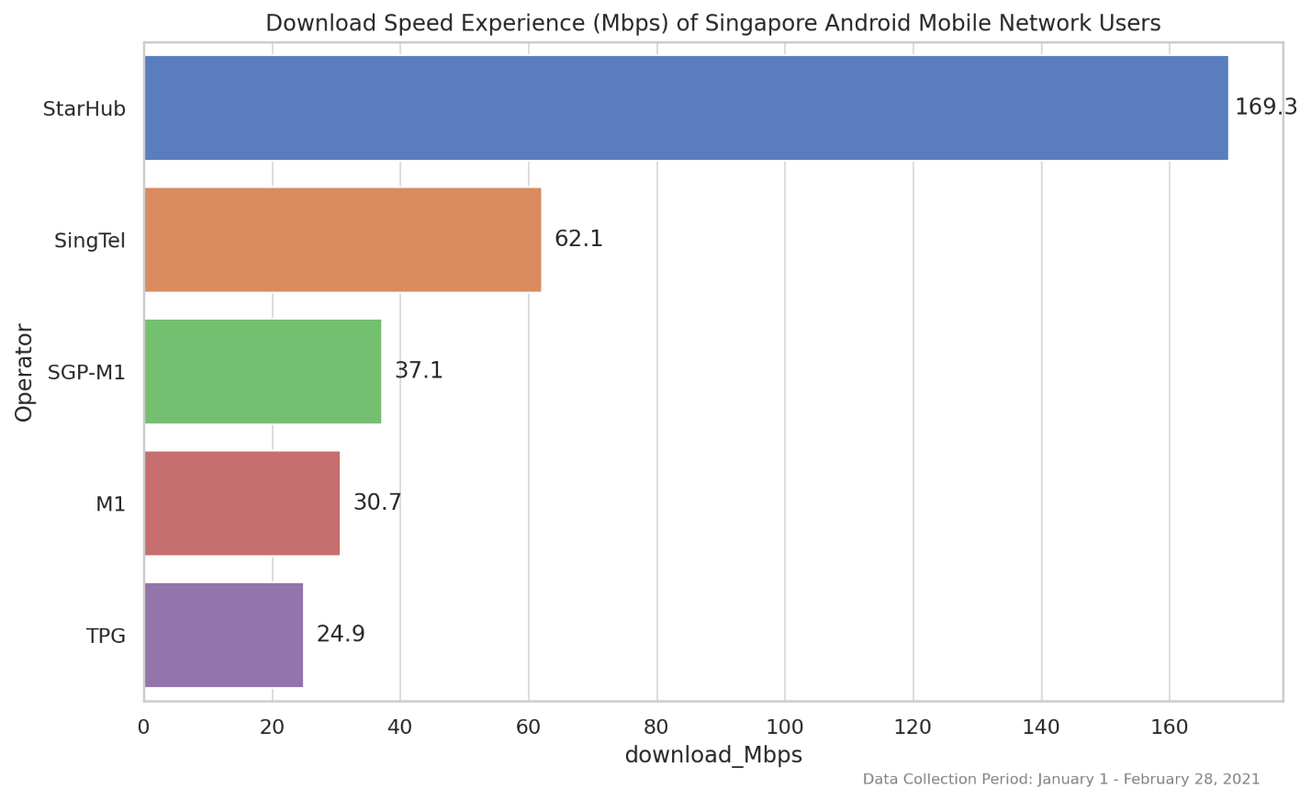
StarHub Users See The Fastest Download Speeds

Slide 10
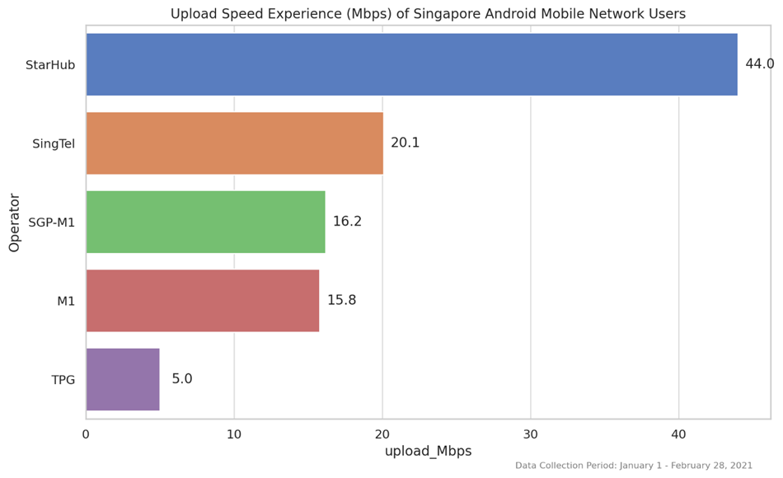
StarHub Users See The Fastest Upload Speeds

Slide 11
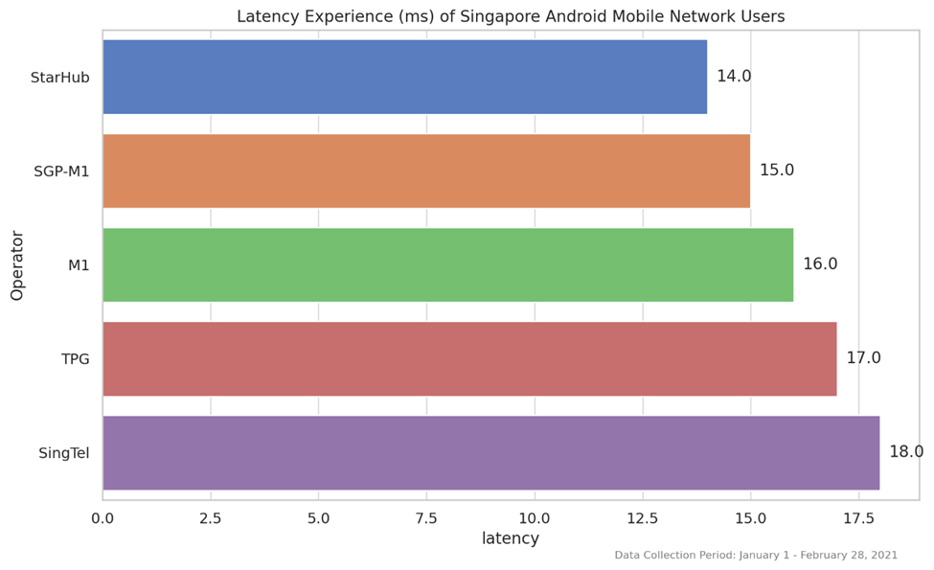
StarHub Users See The Lowest Latency

Slide 12
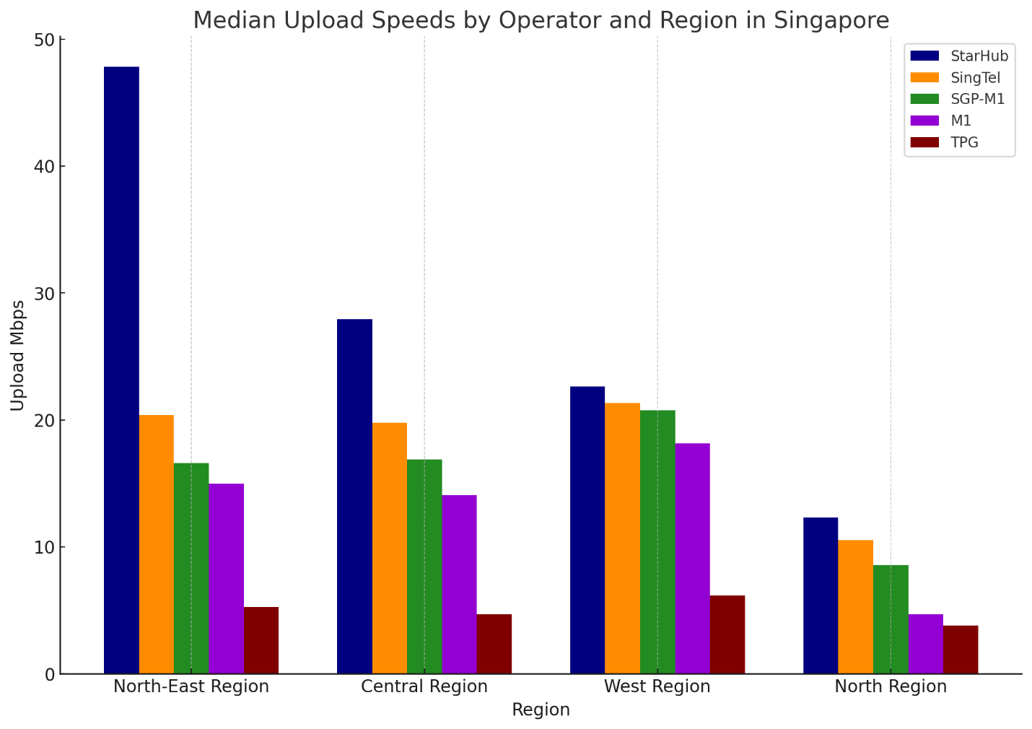
Singtel and SGP-M1 Users experience similar UL speeds compared to StarHub in West and North Region

Slide 13
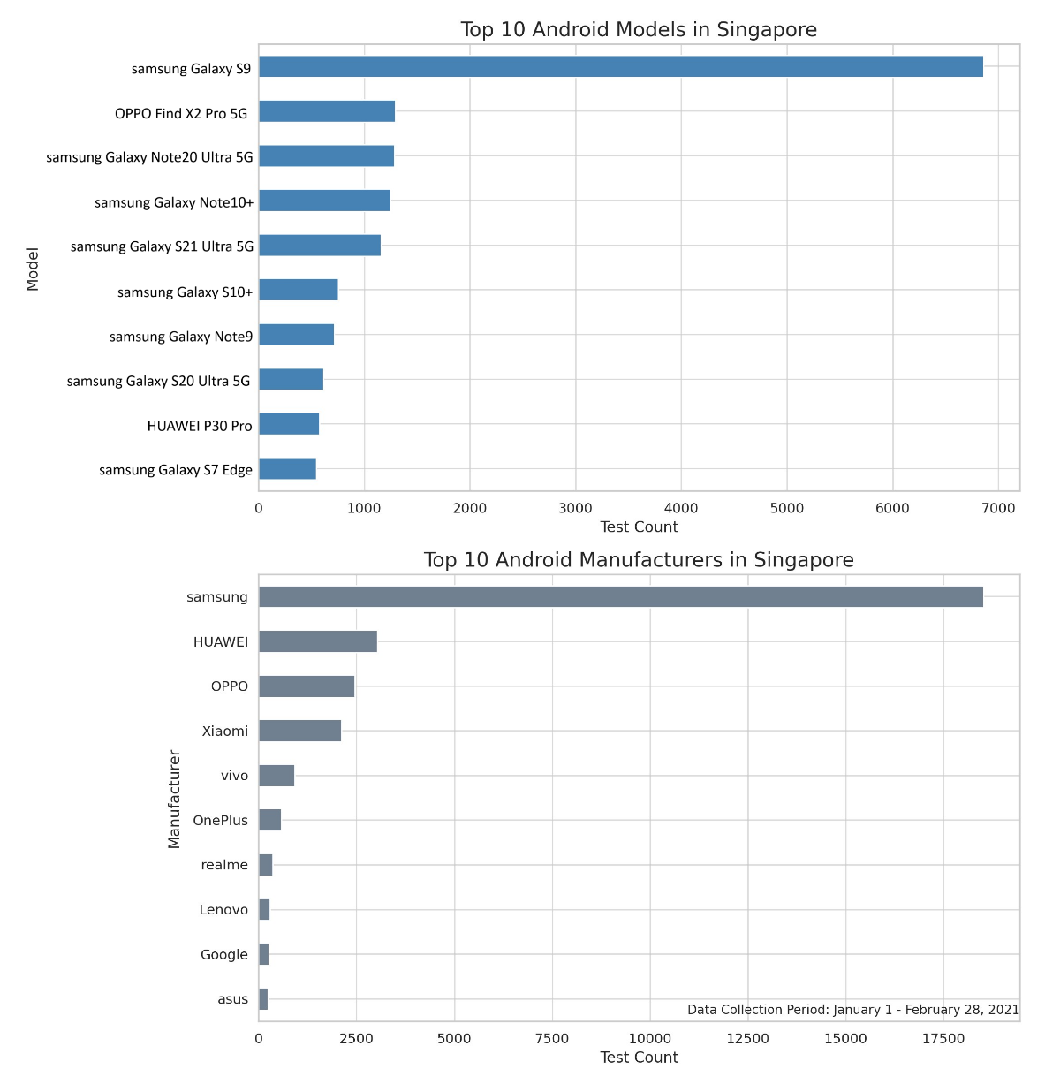
Device Analysis - Insights on the top 10 device models and manufacturers
Brand Dominance: Samsung dominates the market significantly among domestic users in Singapore. This is followed by other brands like HUAWEI, OPPO, and Xiaomi.
Model Preference: Specific models, particularly from Samsung, are highly prevalent, especially the Samsung Galaxy S9.

Slide 14
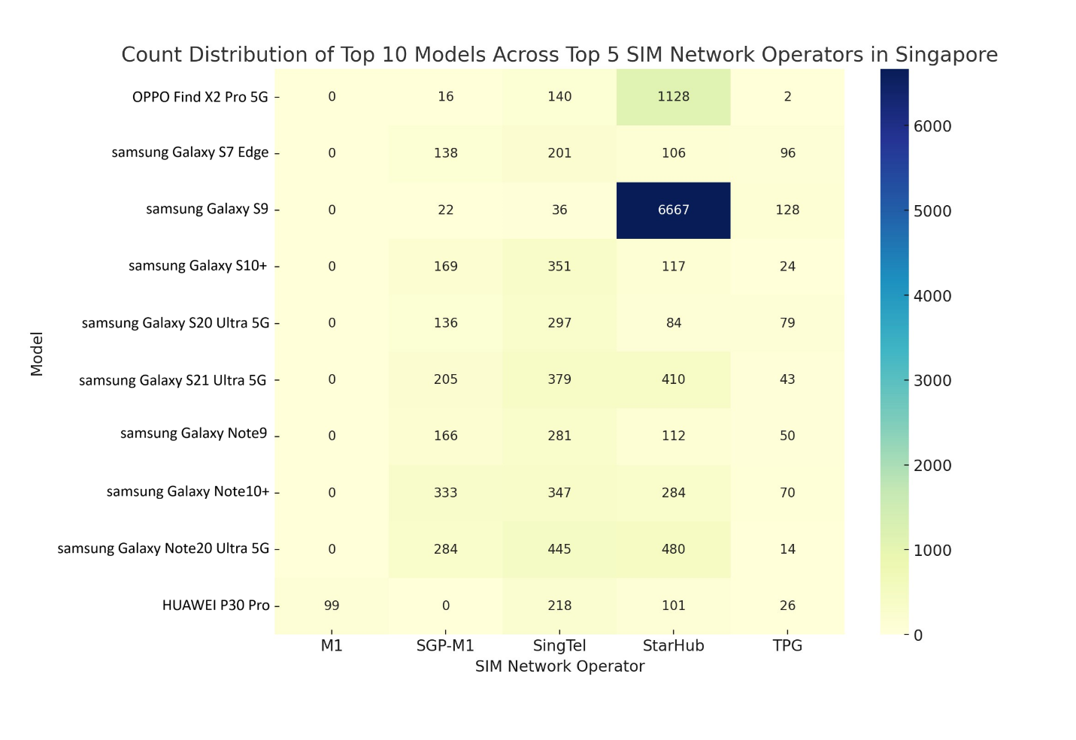
The top model devices distributed among the top 5 network operator
Network Preferences for Specific Models: Certain models show a strong preference or dominance on specific networks. For instance, the Samsung Galaxy S9 model is overwhelmingly used on the StarHub network.
Model Diversity Across Networks: Some models are more evenly distributed across multiple networks. Samsung Galaxy S21 shows a more balanced distribution across StarHub, SGP-M1, and SingTel.

Slide 15
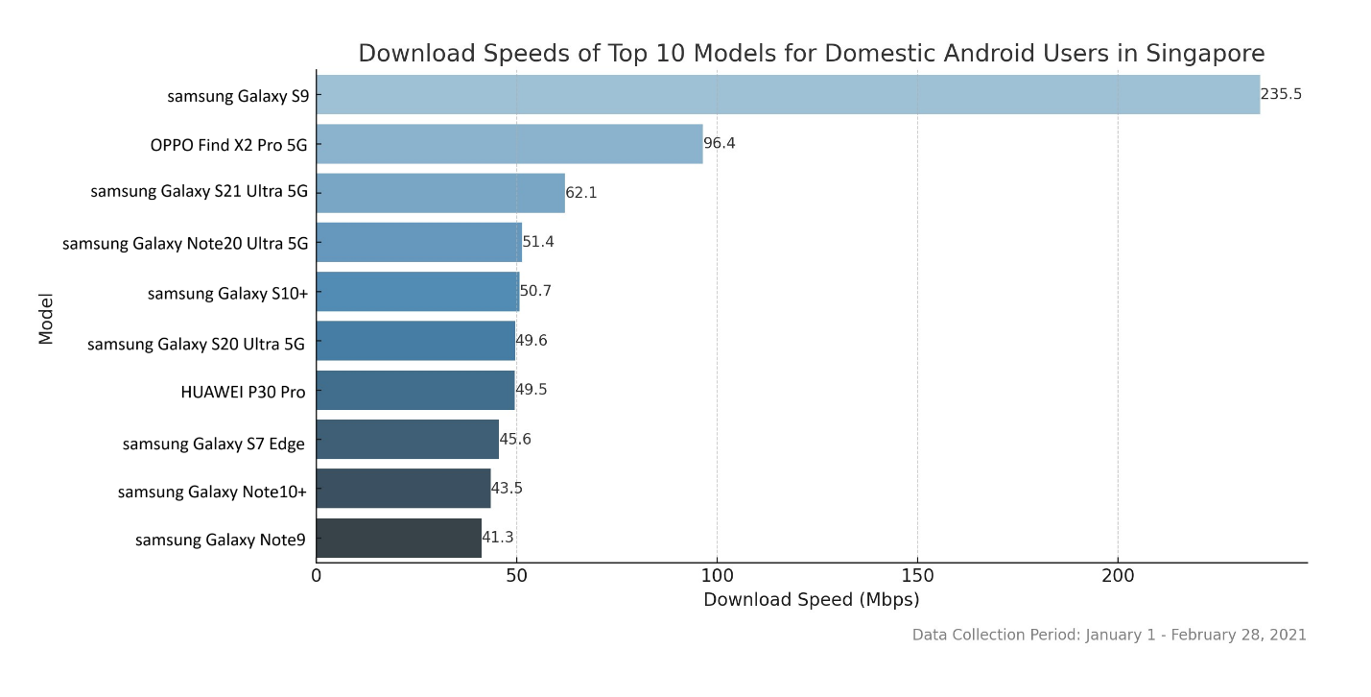
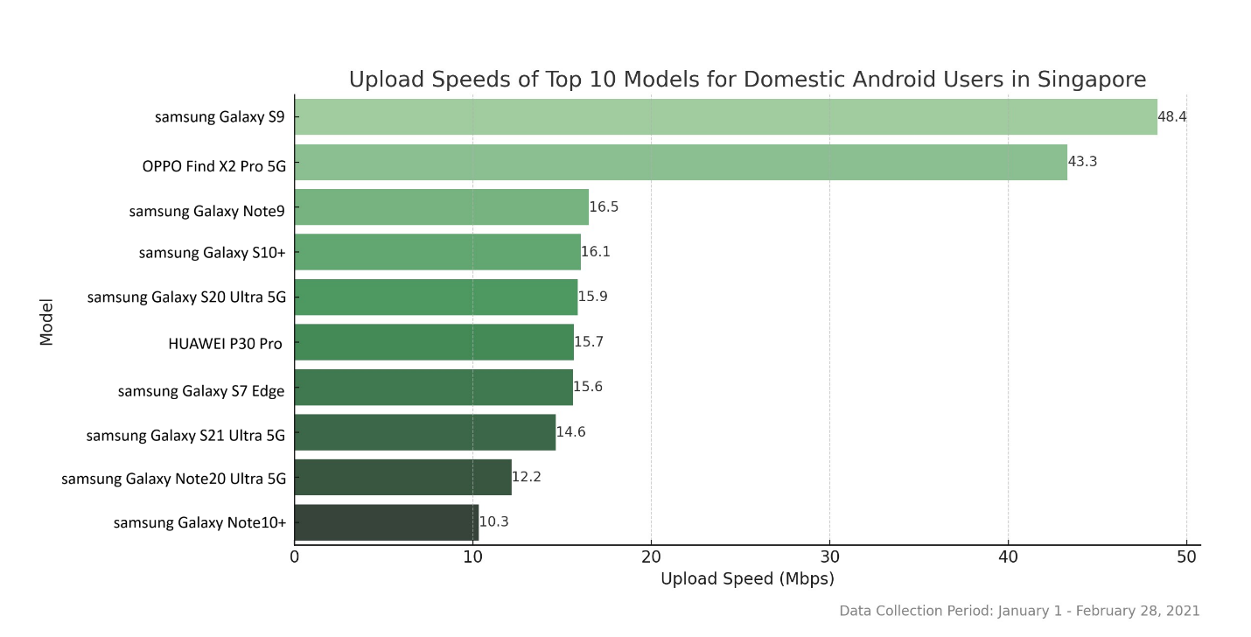
Device-Specific Performance Analysis
Notes:
The visualizations of the median download speeds, upload speeds, and latency for the top 10 smartphone models among domestic Android users in Singapore provide several valuable insights:
Download Speed Variability: The models show a wide range of median download speeds, with some models like the SM-G960F reaching as high as 235.5 Mbps. This indicates that certain models are capable of achieving significantly higher download speeds, possibly due to better hardware compatibility with network technologies or more advanced features.
Upload Speed Trends: Similar to download speeds, there's variability in upload speeds among models. The SM-G960F again stands out with a high upload speed of 48.4 Mbps. The variation in upload speeds can be attributed to different hardware capabilities and how well these devices can handle data upload tasks.
High-Performance Models: Models like the SM-G960F and CPH2025 exhibit both high download and upload speeds, indicating that they are likely equipped with advanced technology that optimizes network usage.
Implications for Network Planning: These insights are crucial for network operators and planners. Understanding which models are widely used and their respective network performance can help in optimizing the network to cater to the most common devices. This ensures a better overall user experience and can guide decisions regarding network upgrades and capacity planning.
Device Optimization: For device manufacturers and application developers, this data can be used to optimize their products and services for the most commonly used models to ensure better performance and user satisfaction.
Marketing and Sales Strategies: The popularity and performance of certain models can guide marketing and sales strategies, particularly in bundling offers or promoting specific models that align well with the network's capabilities.

Slide 16
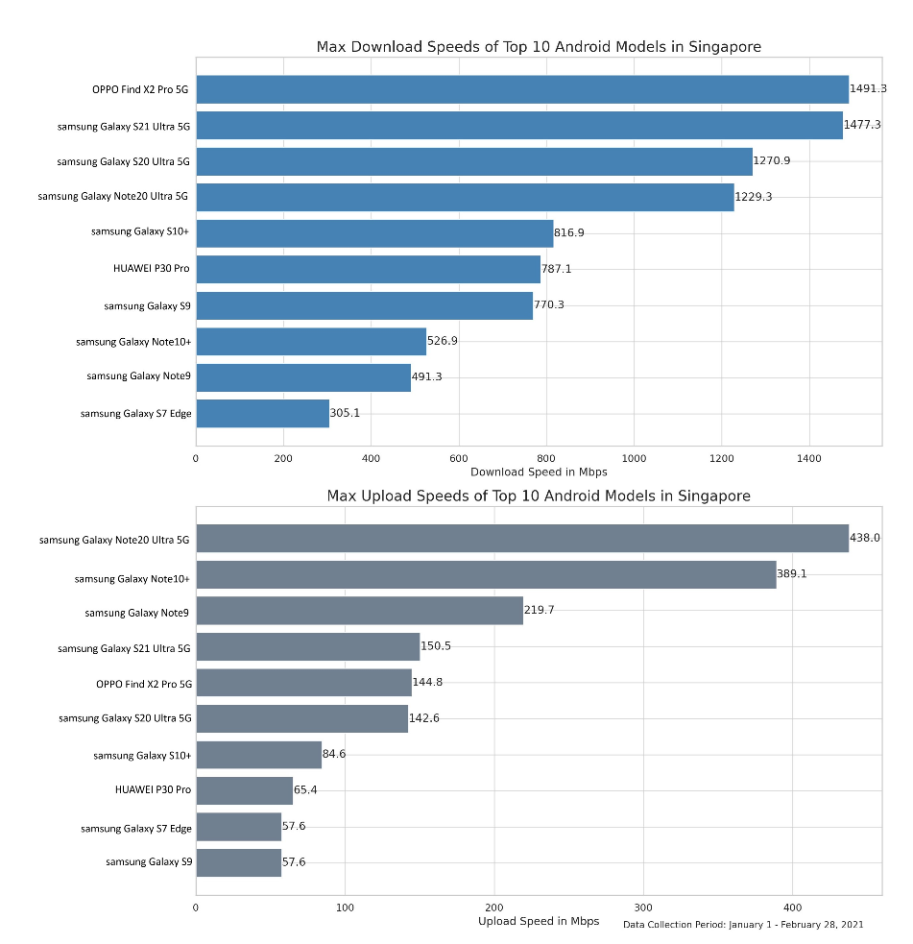
Maximum Speeds of Top Devices

Slide 17
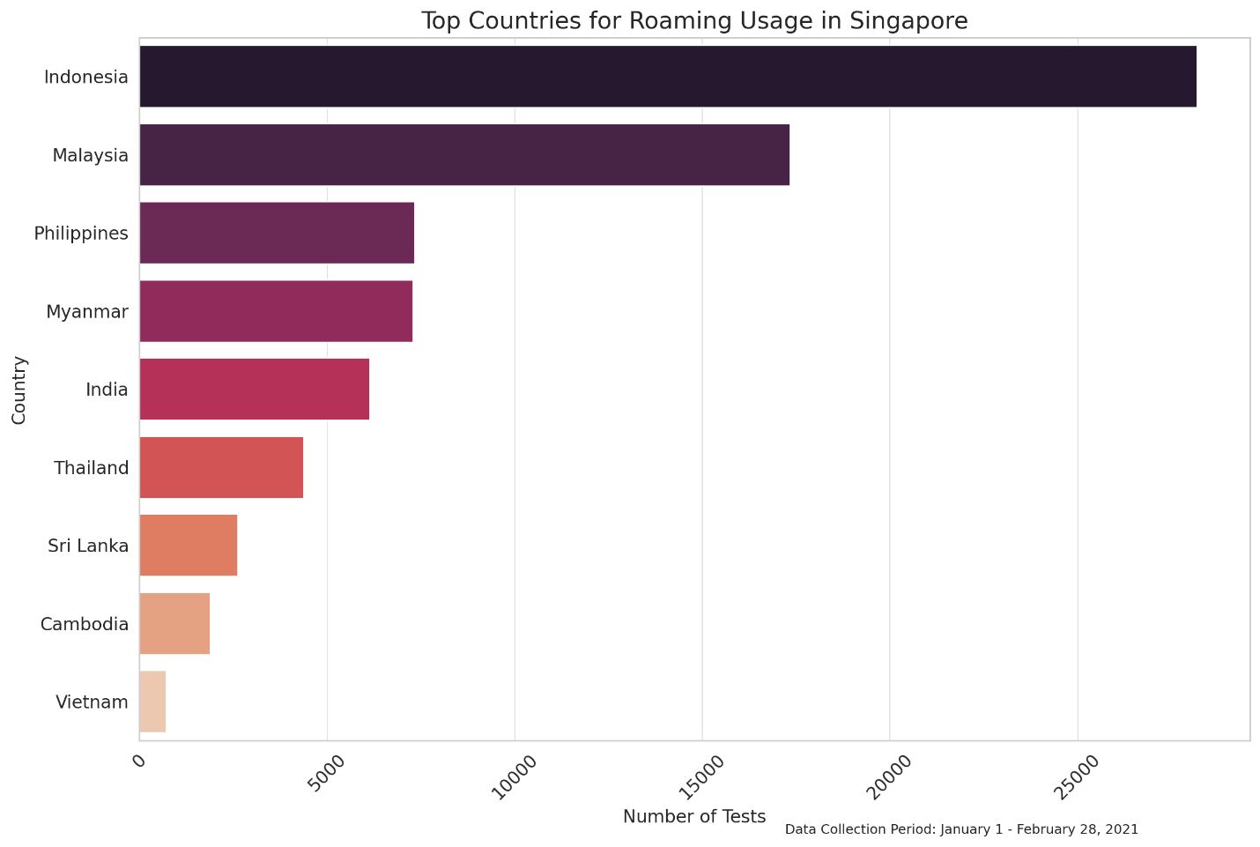
Analyzing the roaming experience of Roaming users in Singapore
Frequency of network tests conducted in Singapore with international SIM cards.
Indonesia and Malaysia top Roamers in Singapore.
Notes:
This visualization effectively highlights the frequency of network tests conducted in Singapore with international SIM cards. It provides a clear perspective on the international connectivity within Singapore, showcasing the diversity of roaming networks used. This information can be crucial for understanding global roaming trends and network performance for users from different countries while they are in Singapore.

Slide 18
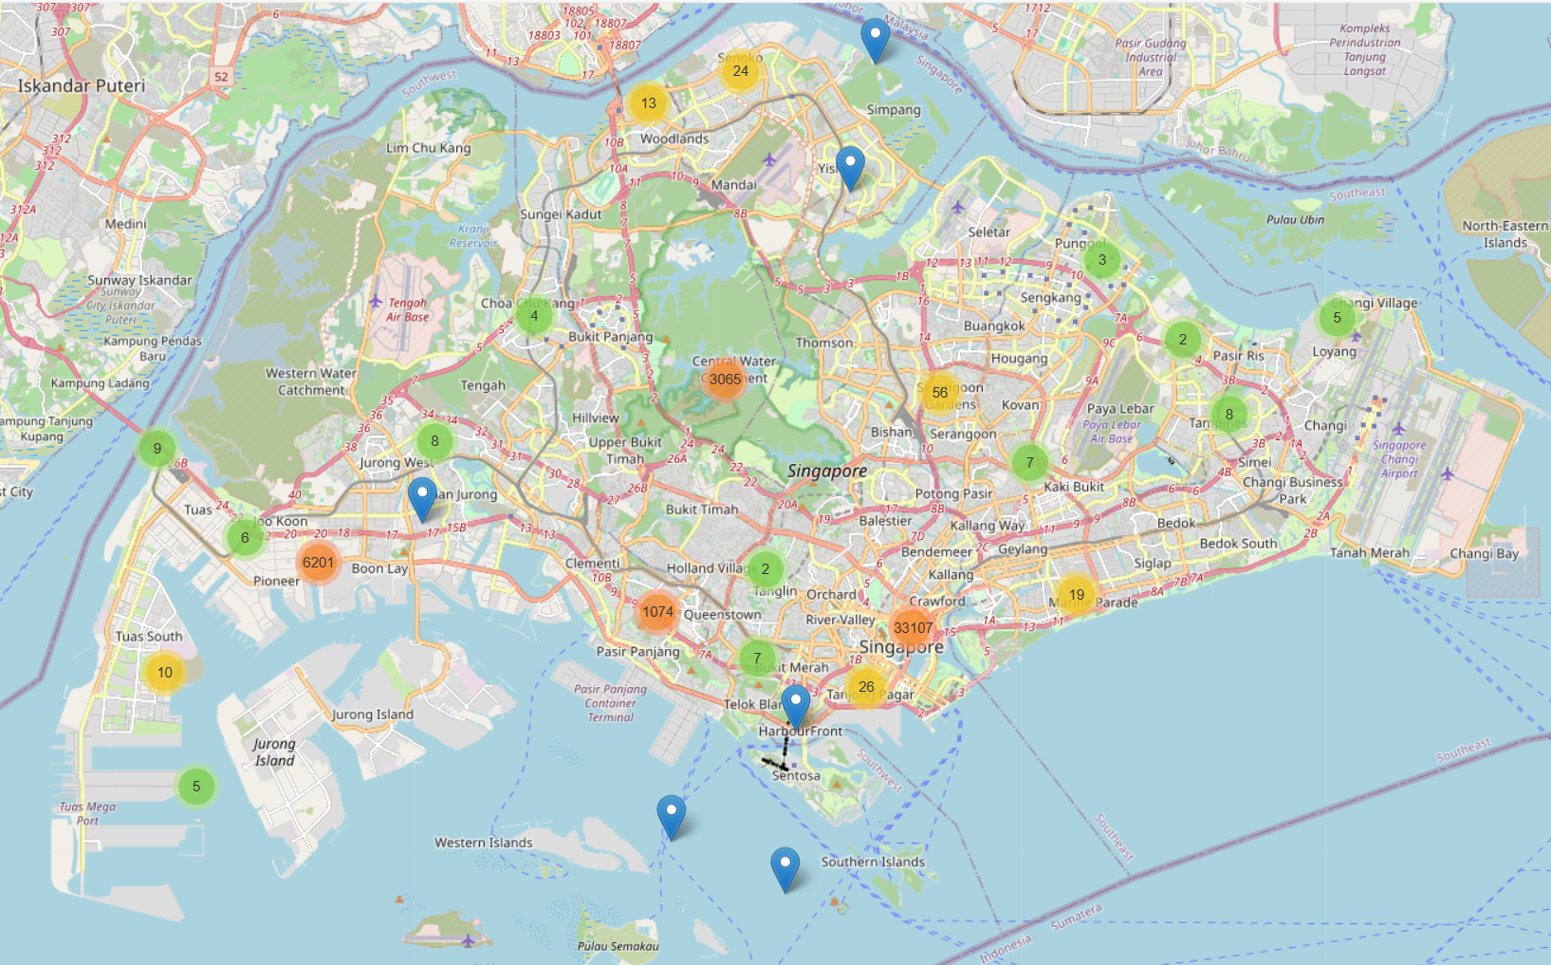
Malaysia and Indonesia users tested mostly in the Central Region while Roaming in Singapore
Notes:
The observation that most tests performed by roamers with test_mcc_a values of 510 and 502 in Singapore were conducted in the central region, with a total of 33,107 tests, provides valuable insights:
Roaming Hotspots: The central region of Singapore is likely a hotspot for international visitors who are roaming, possibly due to tourist attractions, business districts, or transport hubs like Changi Airport.
Network Load: This area may experience a higher load on telecom networks, requiring robust infrastructure to handle the increased data and voice traffic from roamers.
Quality of Service: High test counts in this region might indicate that network providers are actively monitoring and optimizing the quality of service to ensure that roamers have a good experience.
Strategic Importance: For telecom operators, such data underscores the strategic importance of the central region for investment in network quality and capacity.
Policy and Planning: For regulatory bodies, these insights might be crucial for policy-making and planning, ensuring that roaming agreements and infrastructural support are adequate to cater to the high demand in these areas.
Commercial Opportunities: The high concentration of roamers could present commercial opportunities, such as targeted advertising, special roaming packages, or partnerships with local businesses.
Event Planning: Event organizers and city planners can use this data to anticipate increased network usage during large gatherings or special events in the central region.

Slide 19
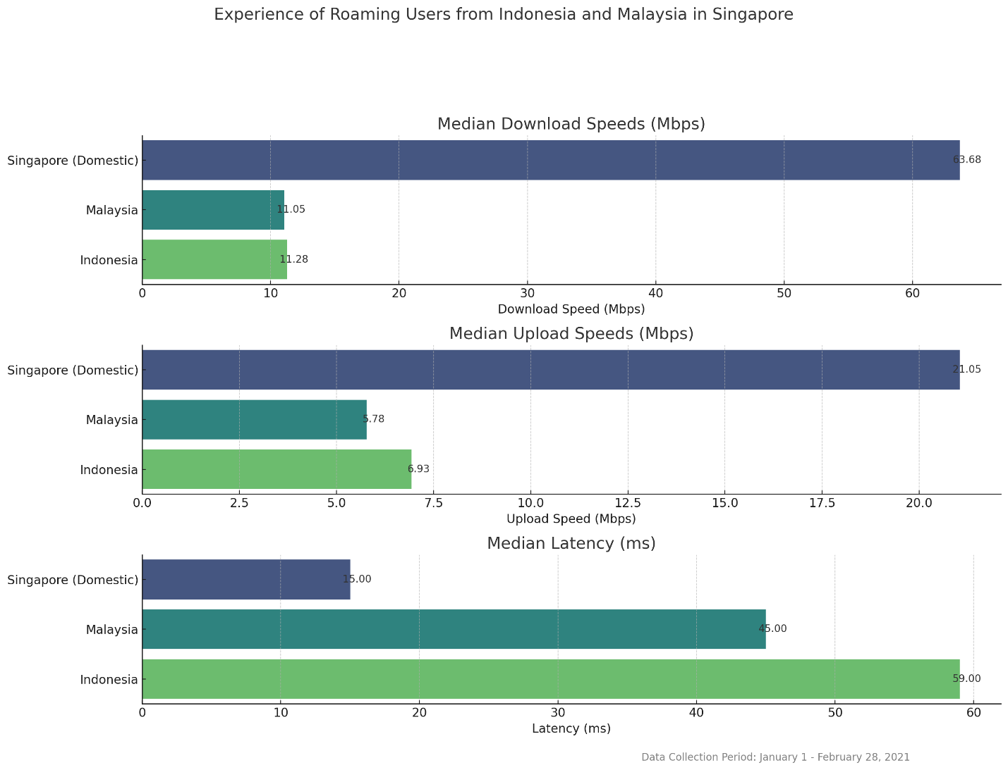
Malaysia and Indonesia users experience lower speeds and increased latency than domestic users when Roaming in Singapore
Notes:
Summary of Insights
Download Speeds: Domestic users in Singapore experience significantly higher median download speeds (approximately 63.68 Mbps) compared to Indonesian and Malaysian roamers, who have median speeds around 11.28 Mbps and 11.05 Mbps, respectively.
Upload Speeds: A similar trend is observed with upload speeds. Singapore's domestic users enjoy a much higher median upload speed of about 21.05 Mbps, whereas Indonesian and Malaysian roamers have median speeds of around 6.93 Mbps and 5.78 Mbps, respectively.
Latency: The median latency for domestic users in Singapore is notably lower (15 ms) compared to that experienced by Indonesian (59 ms) and Malaysian roamers (45 ms). Lower latency is indicative of a more responsive network.

Slide 20
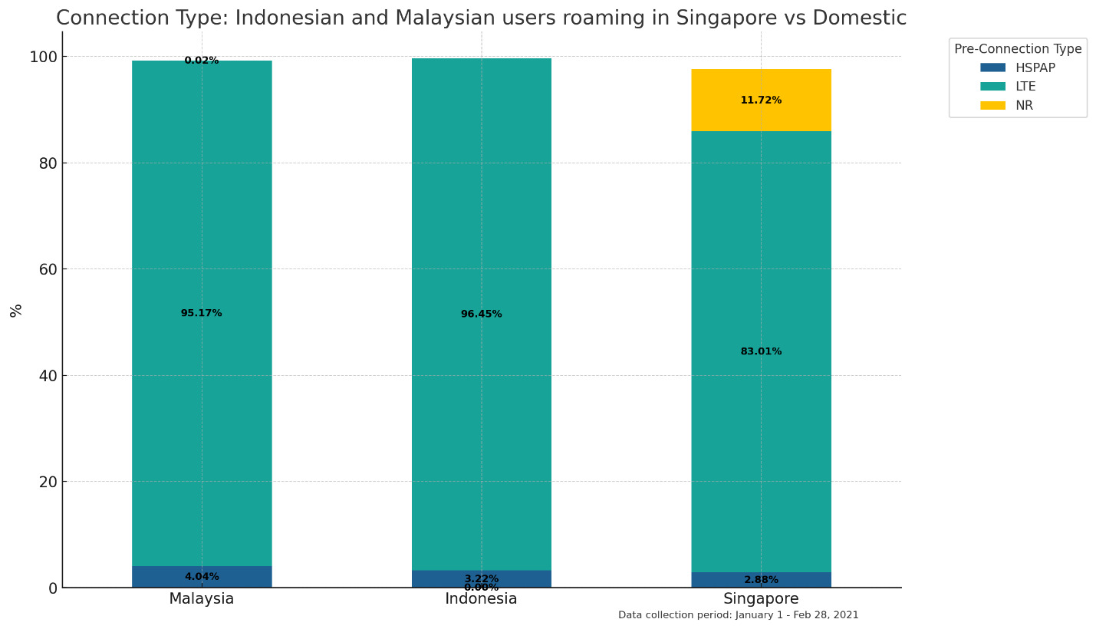
Malaysia and Indonesia users rely on LTE while Roaming in Singapore
No NR connections from roamers vs 11.7% NR connection by domestic Singapore users.

Slide 21
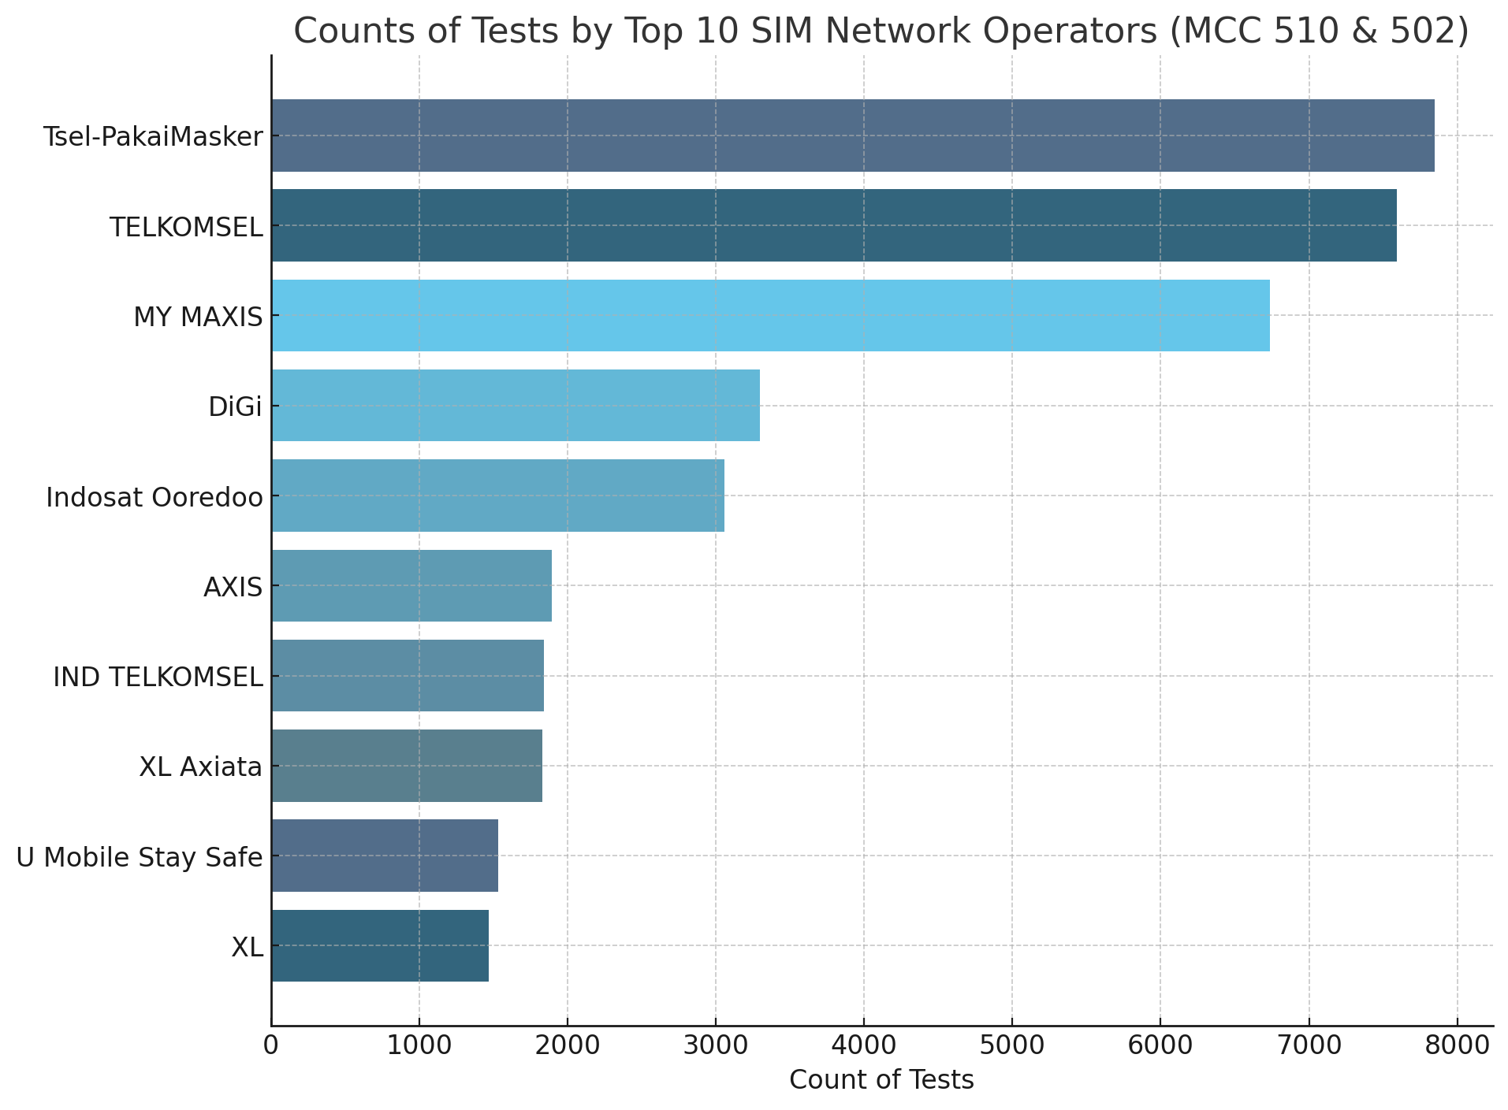
Top Roaming Network Operators from Indonesia and Malaysia roaming in Singapore
Notes:
From the updated visual representation displaying the top roaming network operators from Indonesia and Malaysia in Singapore, with the data collection period noted, we can derive several insights:
Roaming Dominance: The chart indicates that "Tsel-PakaiMasker" and "TELKOMSEL" have the highest number of tests among the roaming networks. This suggests these Indonesian operators are possibly the most preferred or have the largest subscriber base among those roaming in Singapore during the period.
Regional Connectivity: The presence of operators from both Indonesia ("Tsel-PakaiMasker," "TELKOMSEL," "Indosat Ooredoo") and Malaysia ("MY MAXIS," "DiGi") shows significant cross-border mobility between these countries and Singapore, reflecting strong regional connectivity.
Network Performance Evaluation: Roamers are actively testing their network speeds, which could indicate a concern for network performance and a demand for high-quality service while abroad.
Potential for Network Improvement: The fact that roaming subscribers are conducting speed tests could imply a search for the best network performance. This presents an opportunity for local Singaporean operators to optimize roaming agreements and network performance to better serve these customers.
Marketing and Partnership Opportunities: The data highlights which foreign operators' subscribers are most active in Singapore. This can inform local operators about potential partnerships or targeted marketing campaigns.
Consumer Behavior: The need for data connectivity, even when roaming, underscores the modern reliance on mobile services, which could influence package offerings that include better roaming plans or partnerships between home and foreign operators.
Data Collection Period Relevance: The specified period can be correlated with specific events or seasonal travel patterns. For example, if there were any festivals, holidays, or events during this time, it could explain spikes in roaming activities.
Benchmarking and Quality Assurance: For a telecom engineer or a business intelligence analyst, this data can be vital in benchmarking network performance against competitors and in ensuring that quality of service is maintained for roaming subscribers.

Slide 22
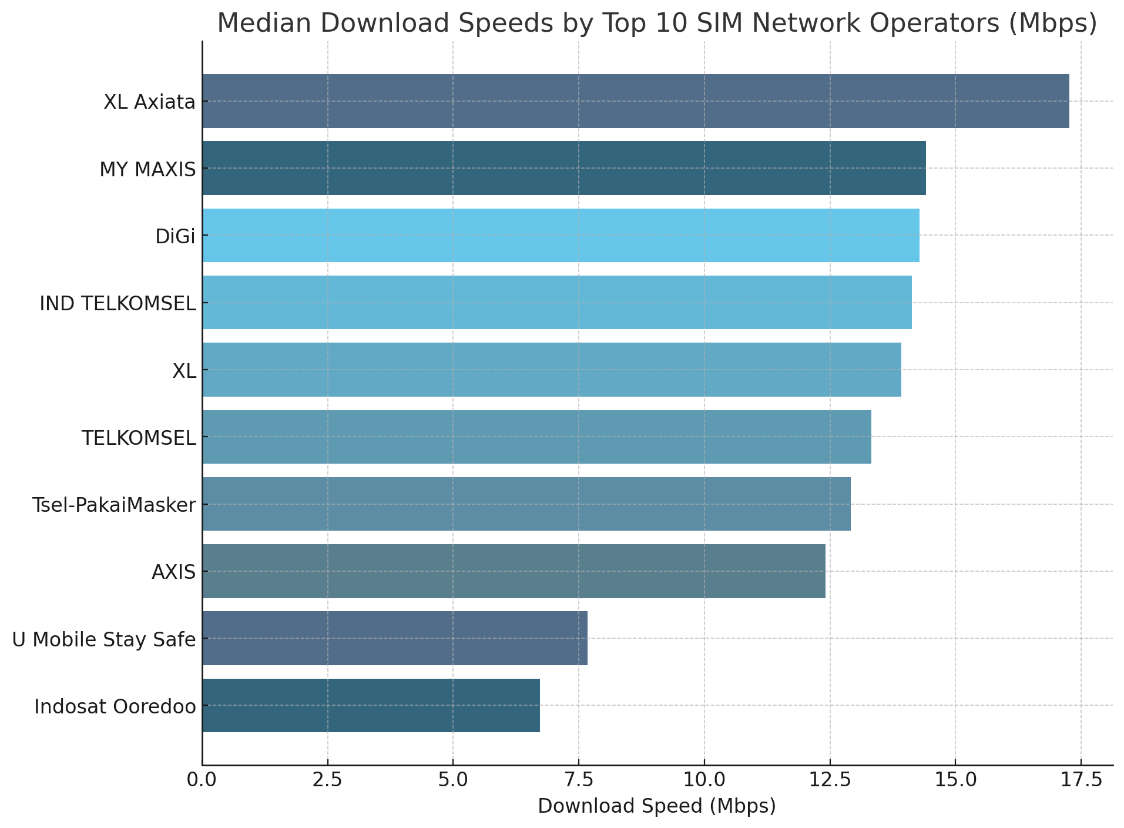
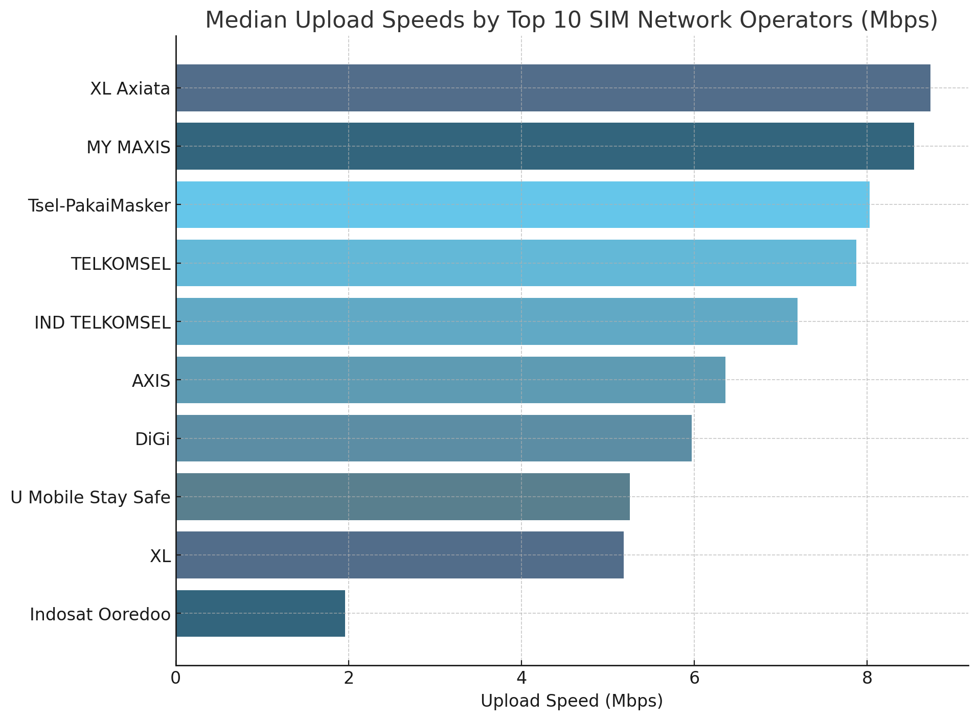
How Malaysia and Indonesia Roaming Experience in Singapore is Affected by Their Choice of Operator

Slide 23
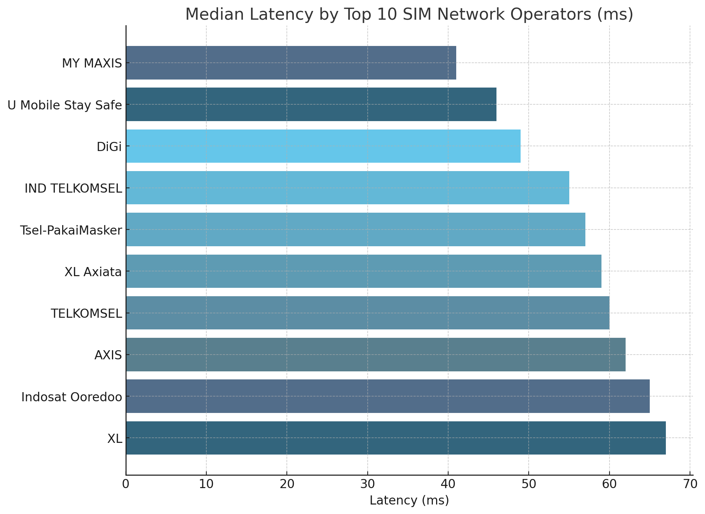
How Malaysia and Indonesia Roaming Experience in Singapore is Affected by Their Choice of Operator

Slide 24
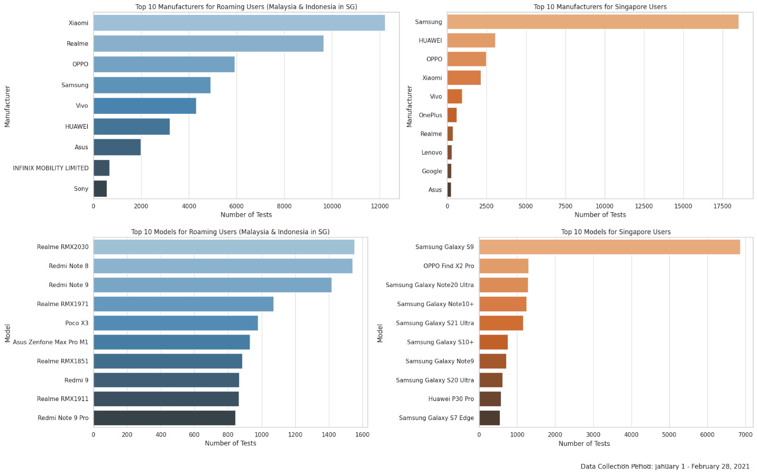
Device Preferences of Roamers
Notes:
Key Insights for Sales Pitch
Diverse Preferences in Roaming Users: Users from Malaysia and Indonesia roaming in Singapore show a strong preference for Xiaomi, Realme, and OPPO devices.
Samsung's Dominance in Singapore: For local Singapore users, Samsung is the most popular manufacturer, with several models among the top 10.

Slide 25
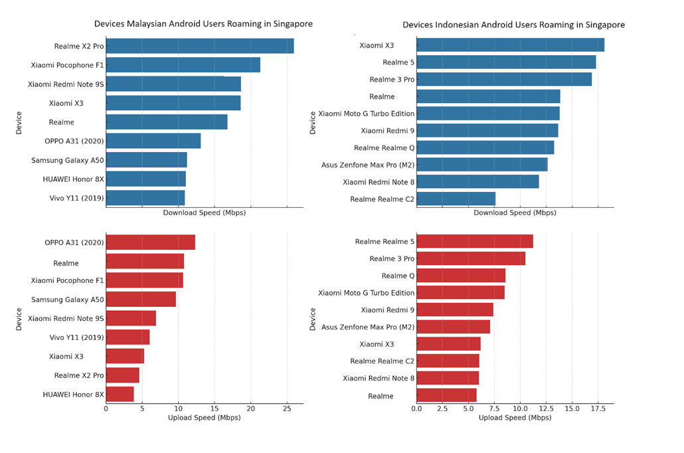
Performance of top 10 Indonesian and Malaysian devices roaming in Singapore
Notes:
Key Observations
Device Preference: Both groups show a preference for mid-range devices, predominantly from brands like Xiaomi and Realme.
Performance: Malaysian devices seem to have slightly better network performance in terms of download speed, but the difference is not substantial.

Slide 26
Conclusion
The data offers valuable insights into the telecom landscape in Singapore, with a specific focus on the experience of domestic and roaming Android users, device preferences, and network performance benchmark of network operators. Here are some key takeaways:
Network Performance Insights:
- Download, upload speeds and latency are essential for benchmarking network performance, identifying areas for improvement, and ensuring customer satisfaction.
- Variability in network speeds across different regions highlights the need for targeted network optimization and infrastructure development.
Network Operator Insights:
- Dominant operators like StarHub and SingTel indicate market leadership and a larger user base.
- The diversity of operators suggests a competitive telecom market in Singapore.
Device Preferences and Performance :
- Samsung dominates the device market among domestic users.
- Xiaomi, Realme, and OPPO are popular among roaming users from Malaysia and Indonesia.
- Certain device models exhibit significantly higher download and upload speeds.
- Understanding the peak capabilities of top devices can be crucial in discussions about network capacity planning.

Slide 27
Roaming Insights:
- The central region of Singapore is a hotspot for international roamers, indicating strategic importance for network providers.
- Variability in network performance between domestic and roaming users emphasizes the need for better network agreements.
- The presence of Indonesian and Malaysian operators in Singapore reflects strong regional connectivity.
Roaming subscribers actively test network speeds, presenting opportunities for local operators to enhance service quality.
Strategic Considerations:
- Telecom providers can use this data for network optimization, capacity planning, customer satisfaction, and strategic partnerships.
- Regulatory compliance and quality benchmarks are critical for maintaining service standards.

